Slide 1


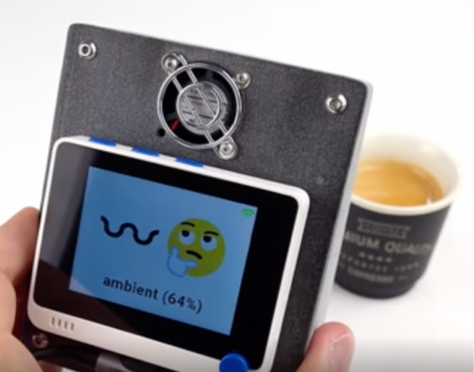
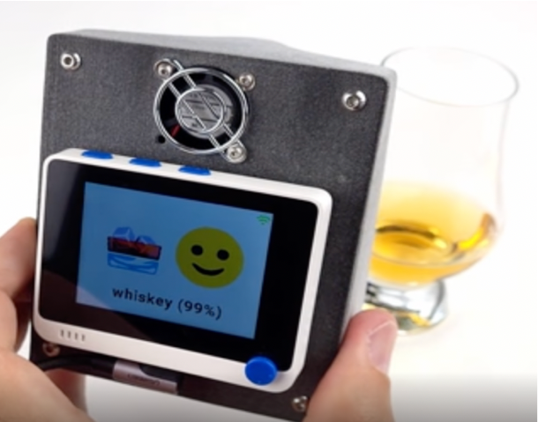


AI Sense - Igor Isaev & Hazel Wat
Mentor: Paul Michael Mora Sancho
& Dr. Tristan Behrens

Slide 2
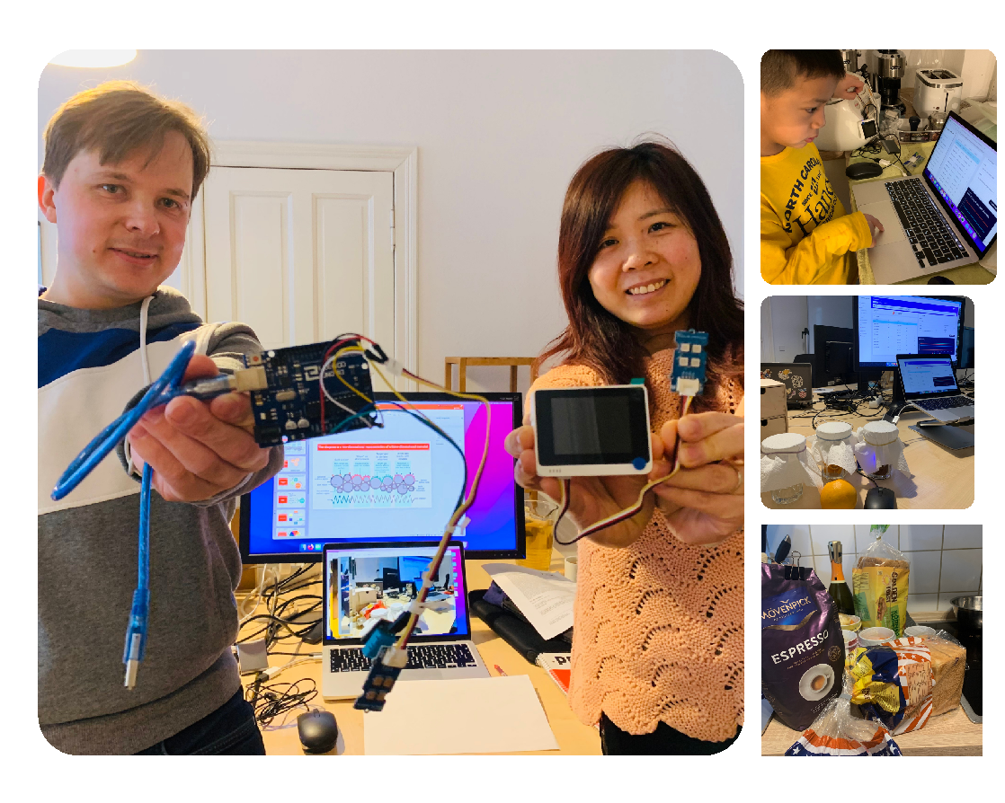

Slide 3
Presentation Overview
Introduction
Possible use cases
Hardware
Data Collection
Predictive Modeling
Lessons learned
Deployment

Slide 4
Supervised Machine Learning & Classification Problem
We are implementing machine learning for detecting different scents.
1. Introduction
Following tasks were done:
Data collection
Data analyse and transformation
Define number of classes to be predicted
Find the most suitable machine learning models
Training
Experiment
Final prototype for common applications

Slide 5
Scent detection has many applications
Anosmia (loss of the sense of smell) is a “neglected disease” which concerns 2% of the global population. The number has significantly increased due to COVID.
Smart Kitchen: Up to 50 Consumer Electronics & Home Appliance application. Products differentiations can be achieved by Smart-Phones’ apps
Health check: Morning: blow into the sensor (watch)
E.g. Your diabetic level is not so good today
E.g. Your oxygen level is not good. Pre-detect Pneumonia / Bronchitis
You are highly stressed
Best Coffee: Helping coffee makers refine the perfect cup. Past difficulties: Extreme difficult to characterise coffee powder e.g. How to identify the qualify before it is brewed?
Spoiled food: A sensor in fridge, e.g. COVID patience who lost taste bud. Binding odor molecules to biosensors. e.g., bad smell, rotten food, spoiled milk
2. Possible use cases

Slide 6
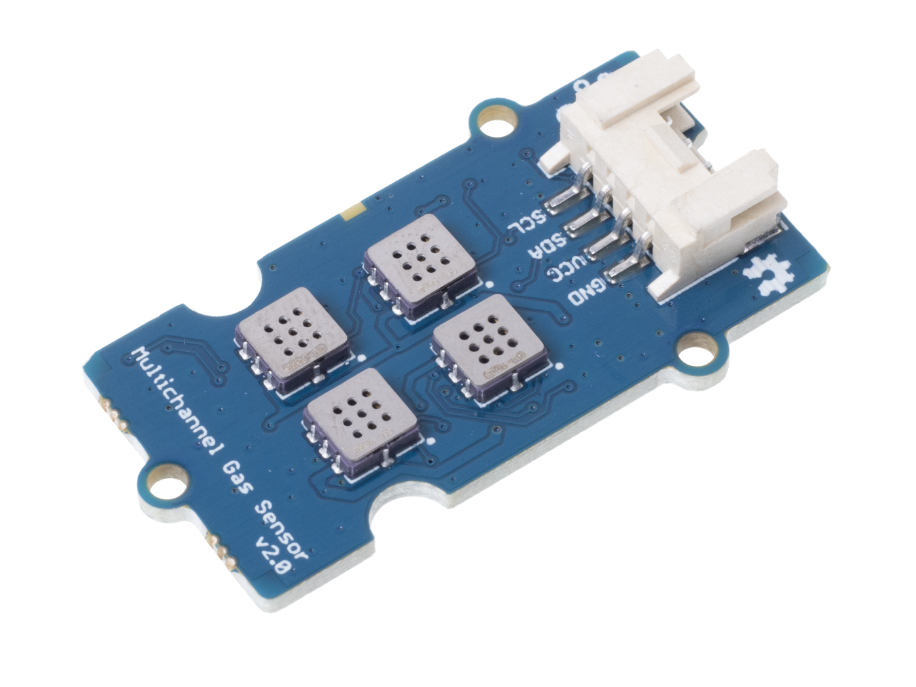
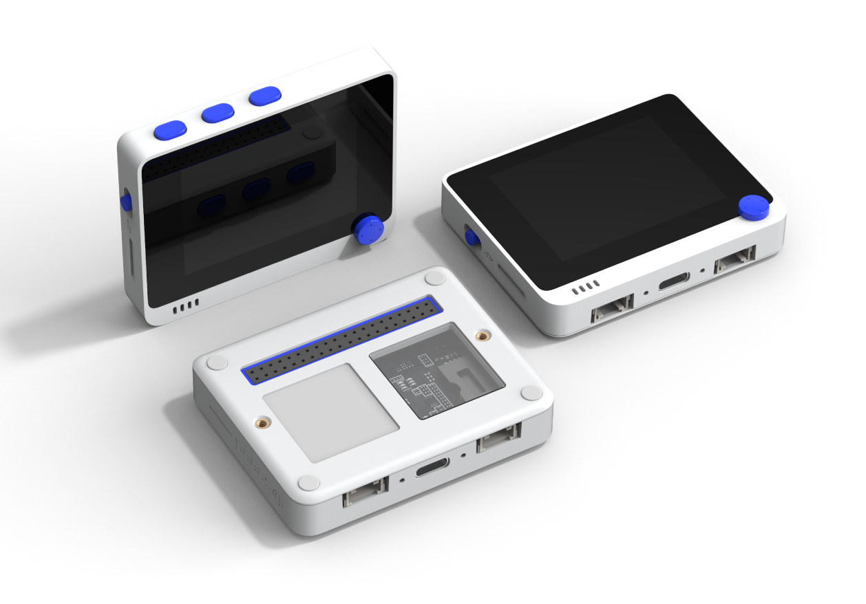
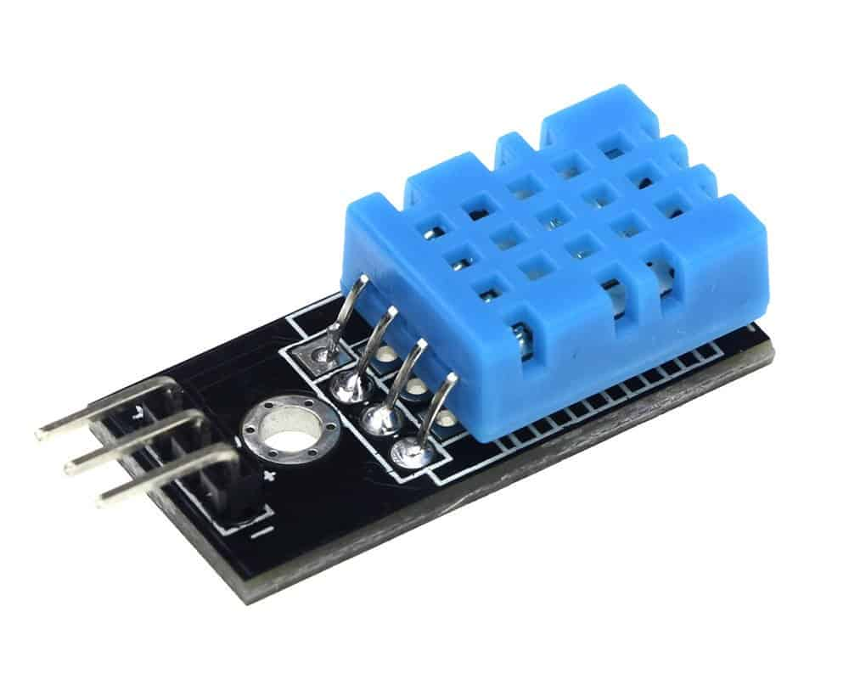
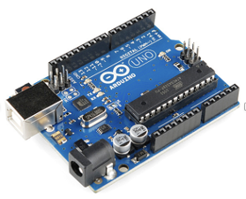
Necessary components
Grove - Gas Sensor V2(Multichannel)
WIO Terminal
3. Hardware
DHT 11: Temperature & Humidity Sensor
Arduino UNO

Slide 7

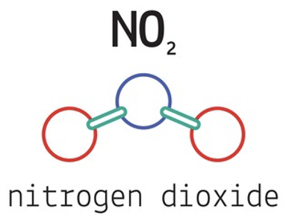
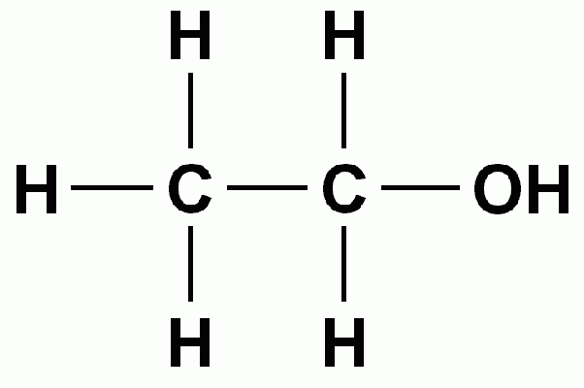



The sensors collected six features
Carbon Monoxide
CO
Nitrogen dioxide NO₂
4. Data Collection
Ethyl alcohol C2H5OH
Volatile organic compounds
VOC
Temperature
Humidity

Slide 8
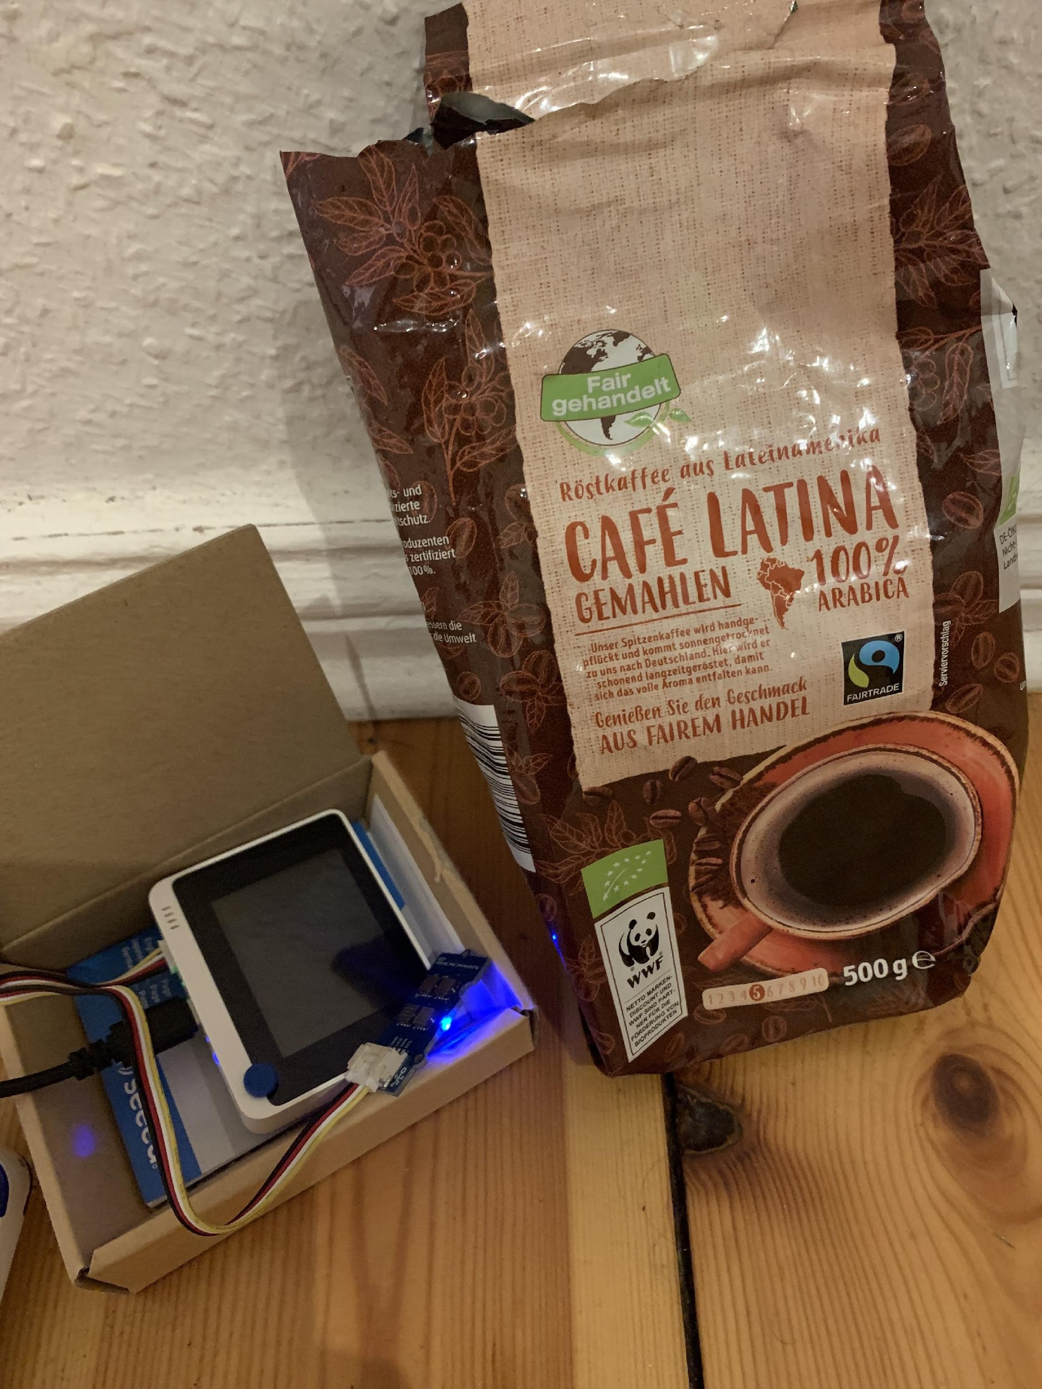
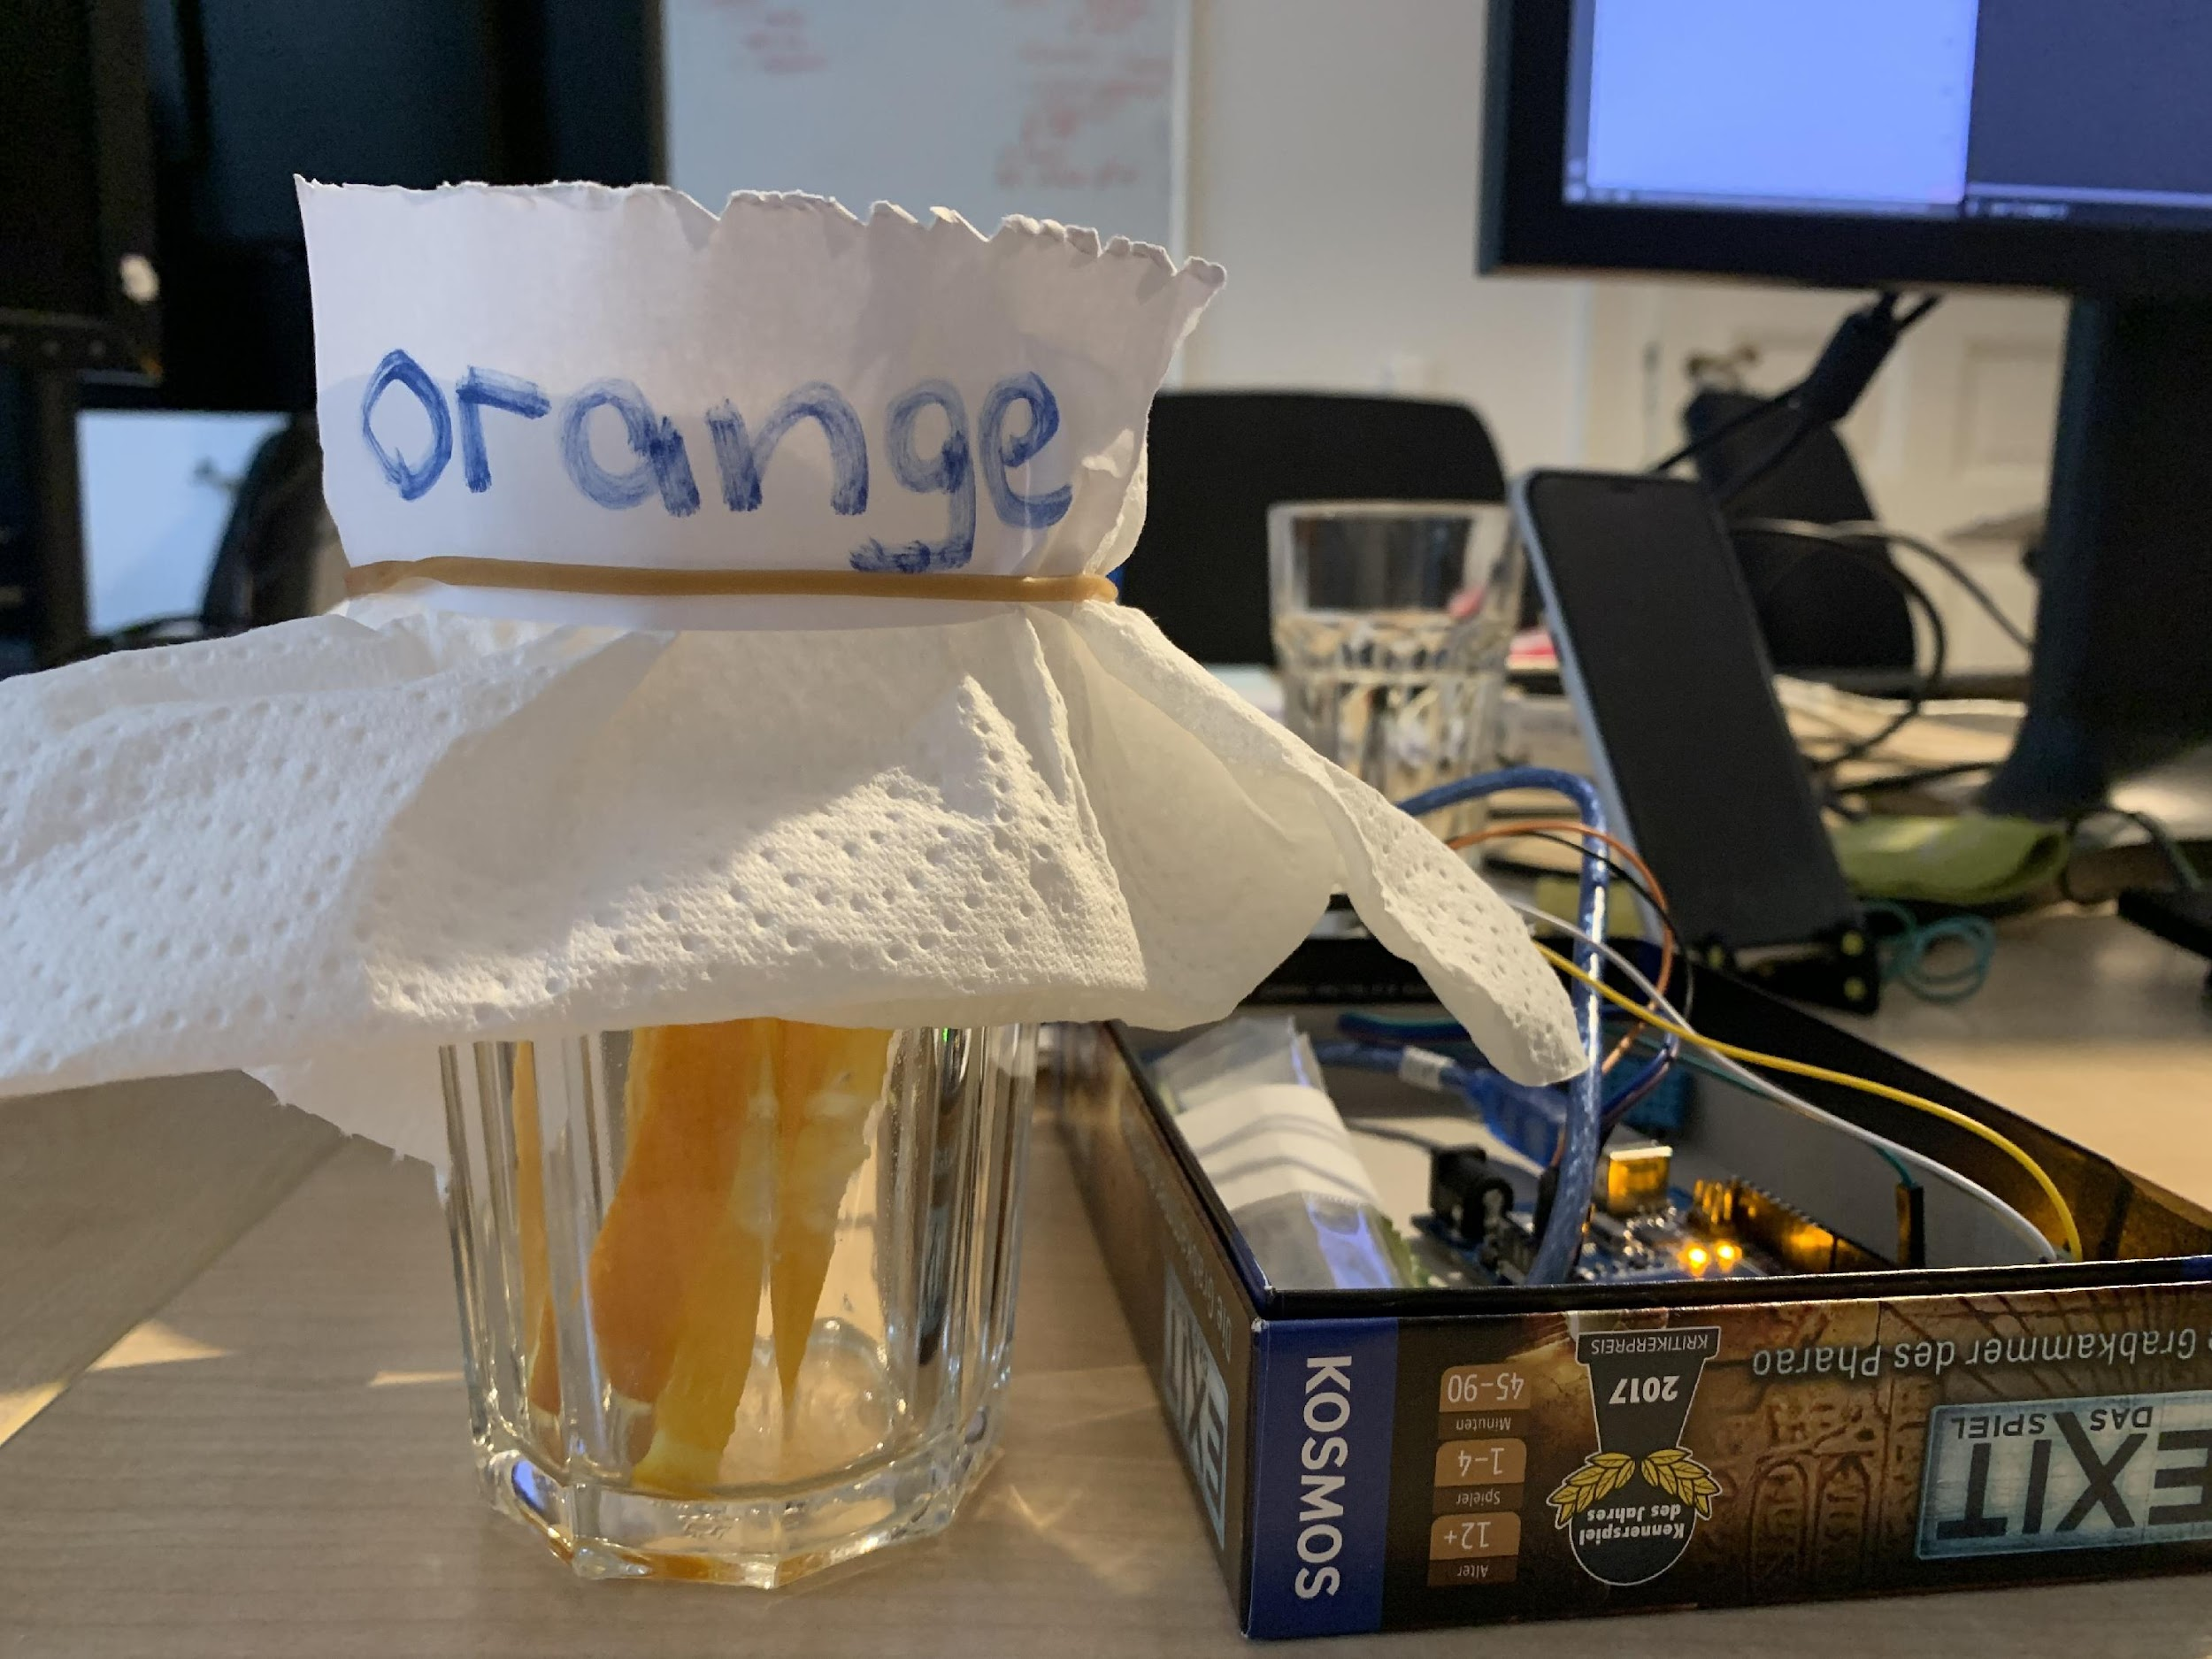
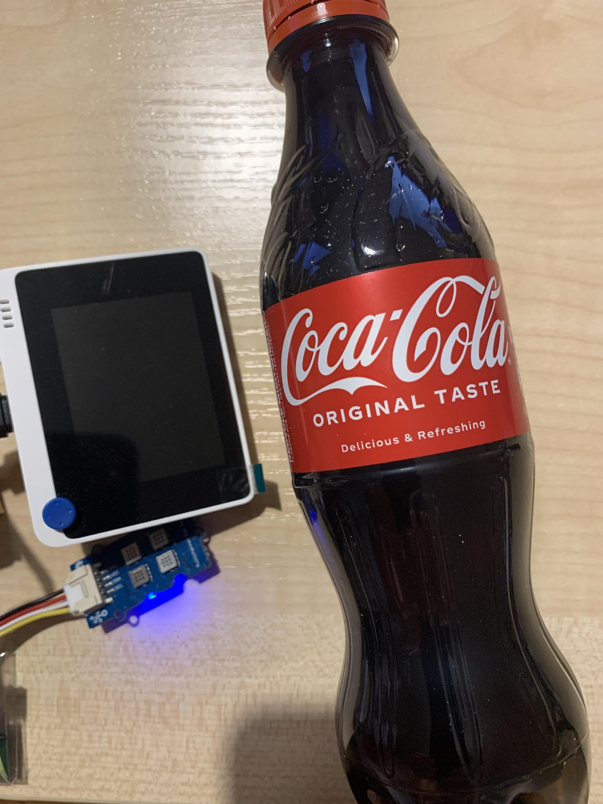
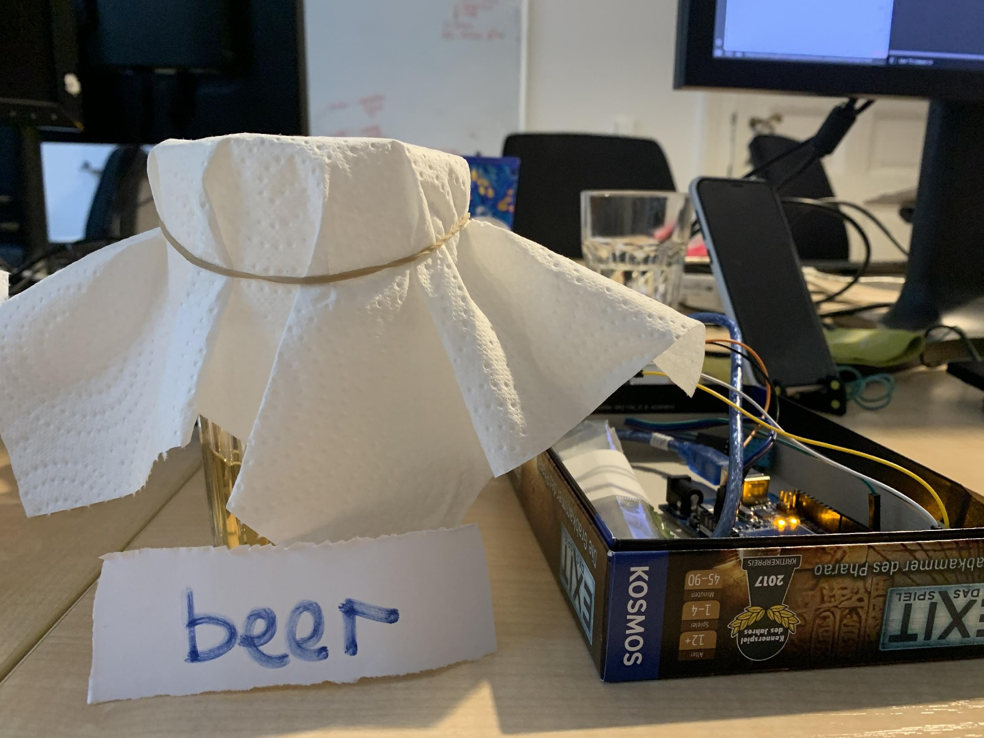
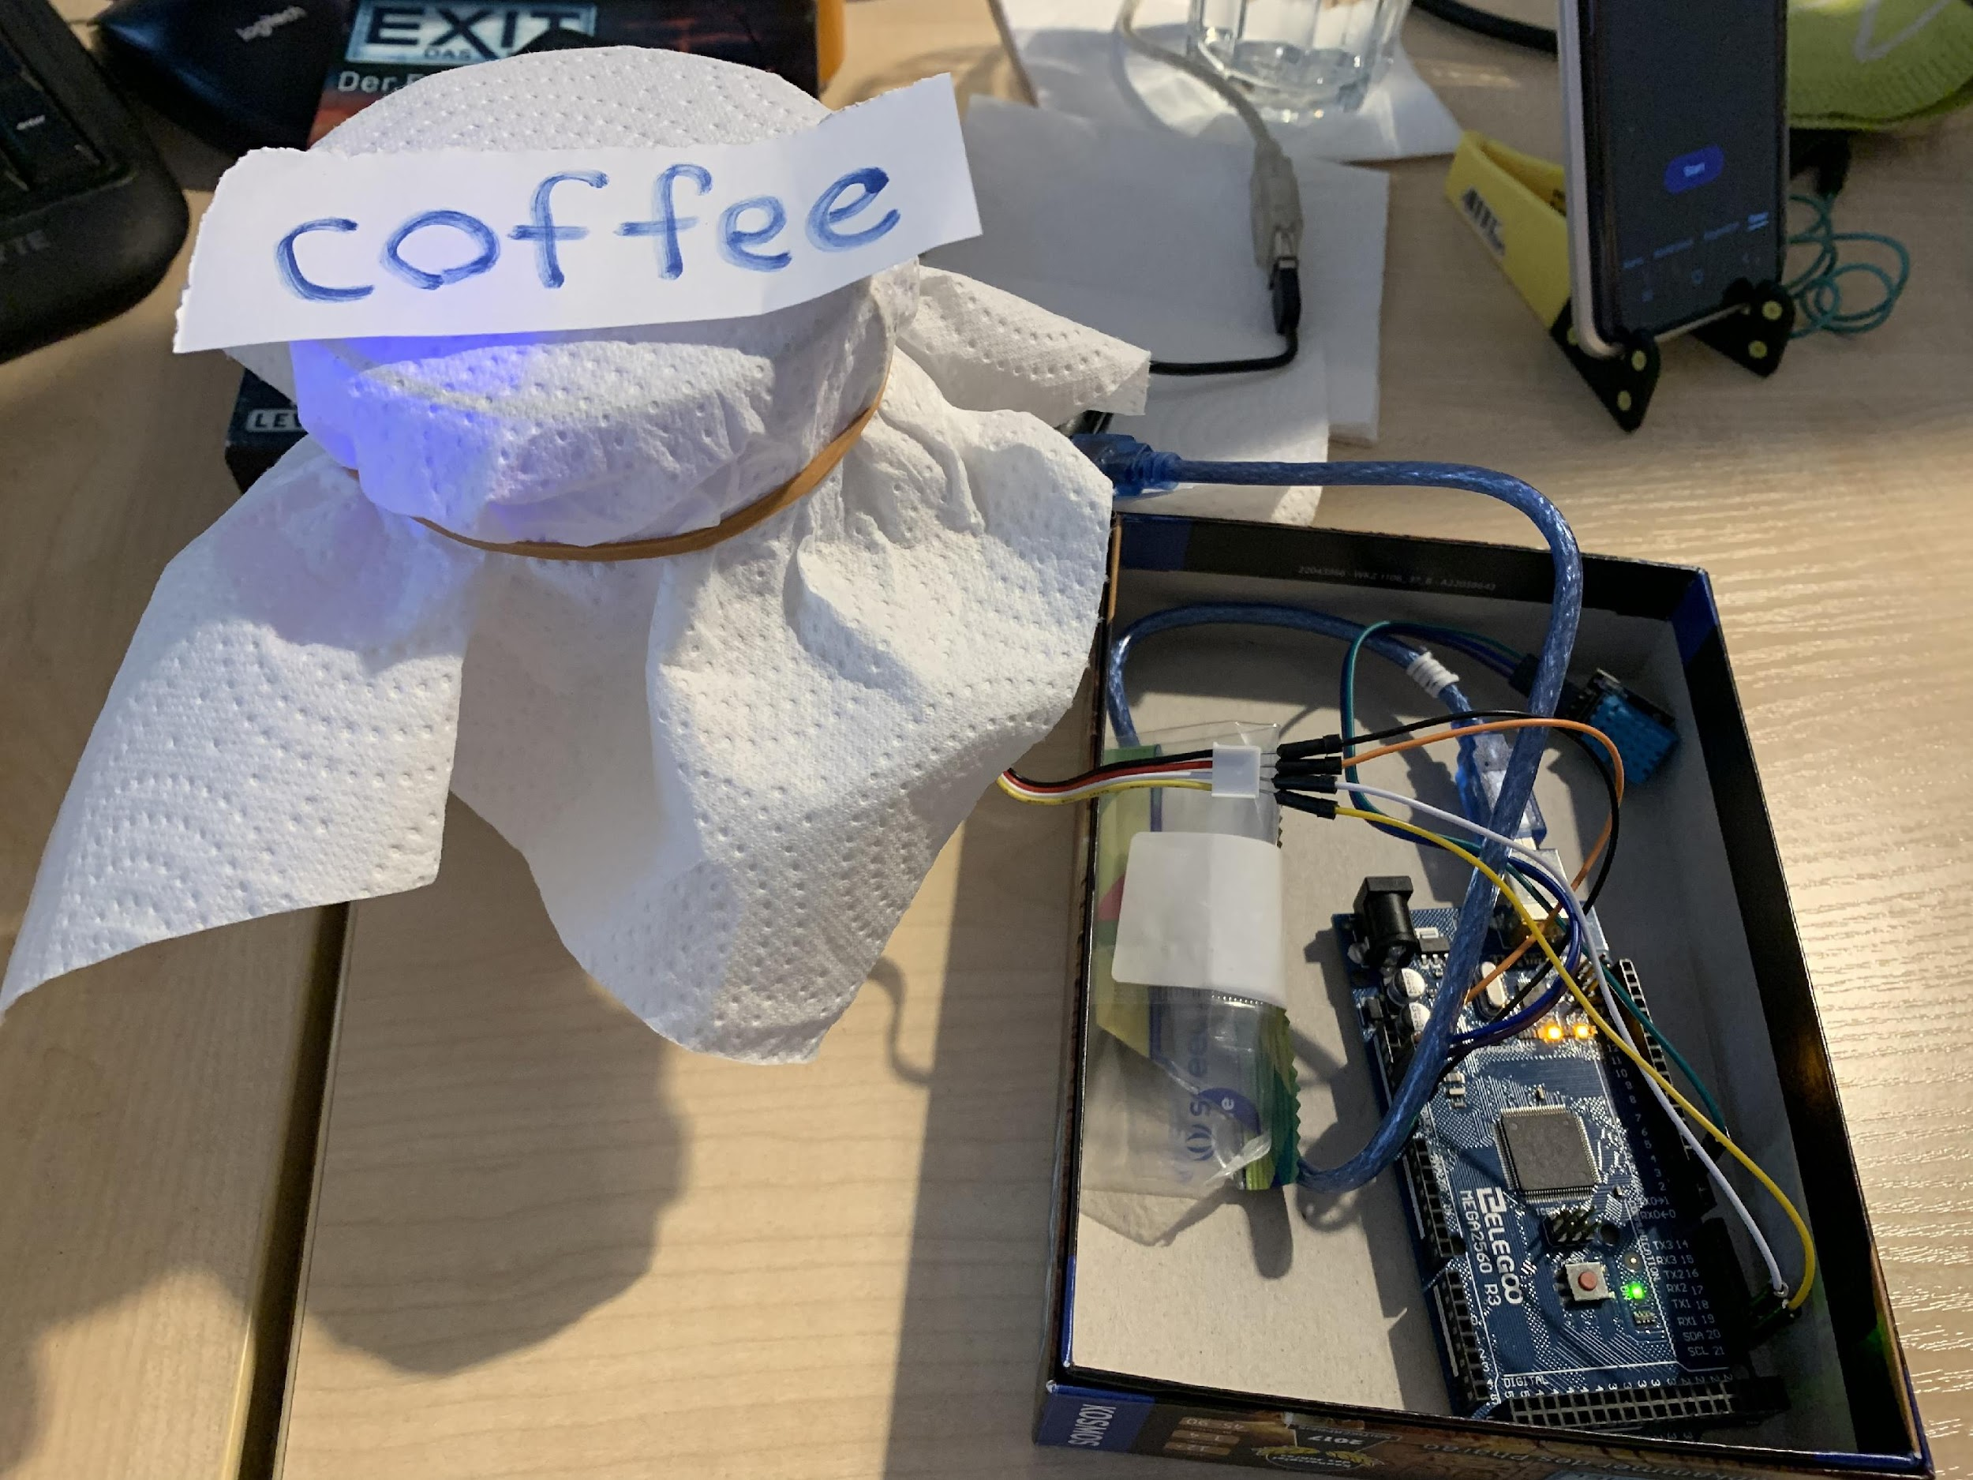
Acquiring Data
Coffee
Beer
4. Data Collection
Orange
Smelling mode

Slide 9
We made sure to balance our dataset
4. Data Collection

Slide 10

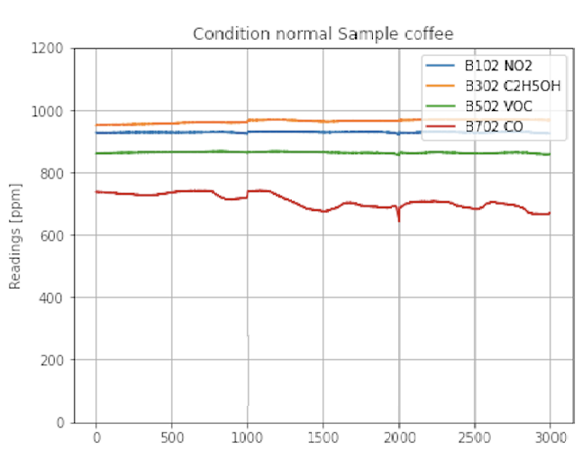
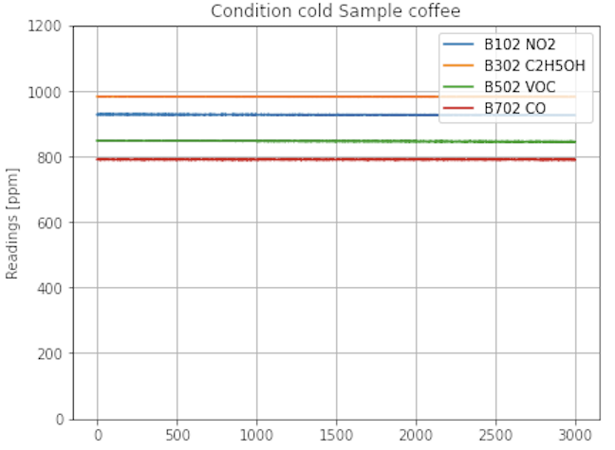
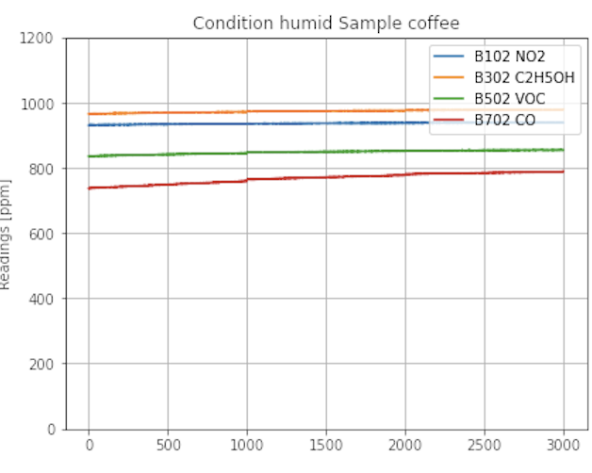
4. Data Collection
Statistics under 3 conditions on same class e.g. coffee
Room temperature
Cold (outside ˜2C)
Humid room

Slide 11
Key Numbers
6
98%
13
Features
4. Data Collection
Testing Accuracy
Classes
4
120
Layers of Fully-connected Neural Network
Seconds
15,600
10
Total Observations
1,200
Hertz
Observations per class

Slide 12
We applied the common candidates of Machine Learning
Teach the model to interpret unseen data, based on historical data. Use this to categorize new data
5. Predictive Modeling
Scikit- learn
Keras
Tensorflow

Slide 13
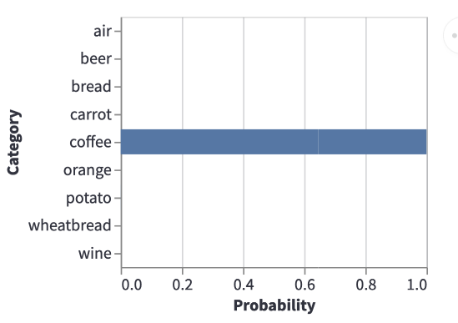



5. Predictive Modeling
Prediction of the class (Probability)
Sample in
Machine Learning Model
Prediction
Sample

Slide 14
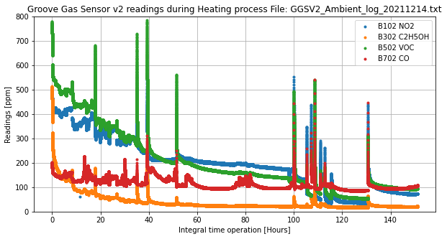
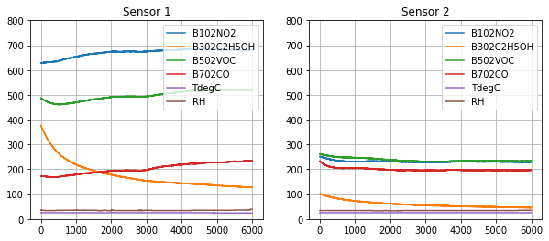
6. Lessons learned
Software
Challenges from Hardware:
Sensors must be preheated 24 hours to show stable results
Sensors are not identical to each other
Heavily depends on environment conditions: temperature, humidity, air flows
Sample acquisition is not instant (takes ~10min to warm up)

Slide 15
Going from Jupyter Notebooks to Deployment
Streamlit
Low latency
User-friendly interface
Real time
7. Deployment
Deployment
Trained model
& Prediction

Slide 16


Slide 17


Slide 18



Connect with us
GitHub: https://github.com/igivis7/DRS28_Hazel_n_Igor_portfolio_project
Igor Isaev
Linkedin: https://www.linkedin.com/in/igor-isaev/
Hazel Wat
Linkedin: https://www.linkedin.com/in/hazelwat/

Slide 19
Appendix

Slide 20
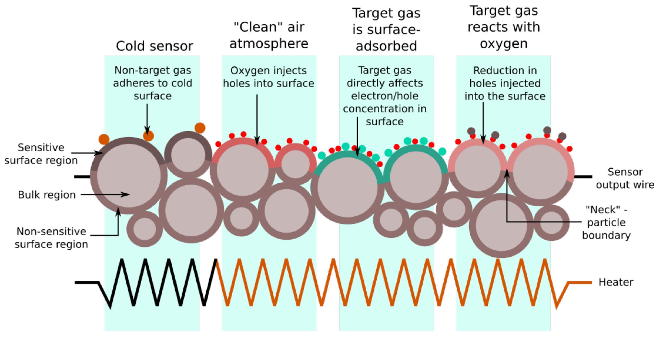
The diagram is a two-dimensional representation of a three-dimensional material
The diagram is a two-dimensional representation of a three-dimensional sensor material

Slide 21
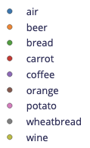
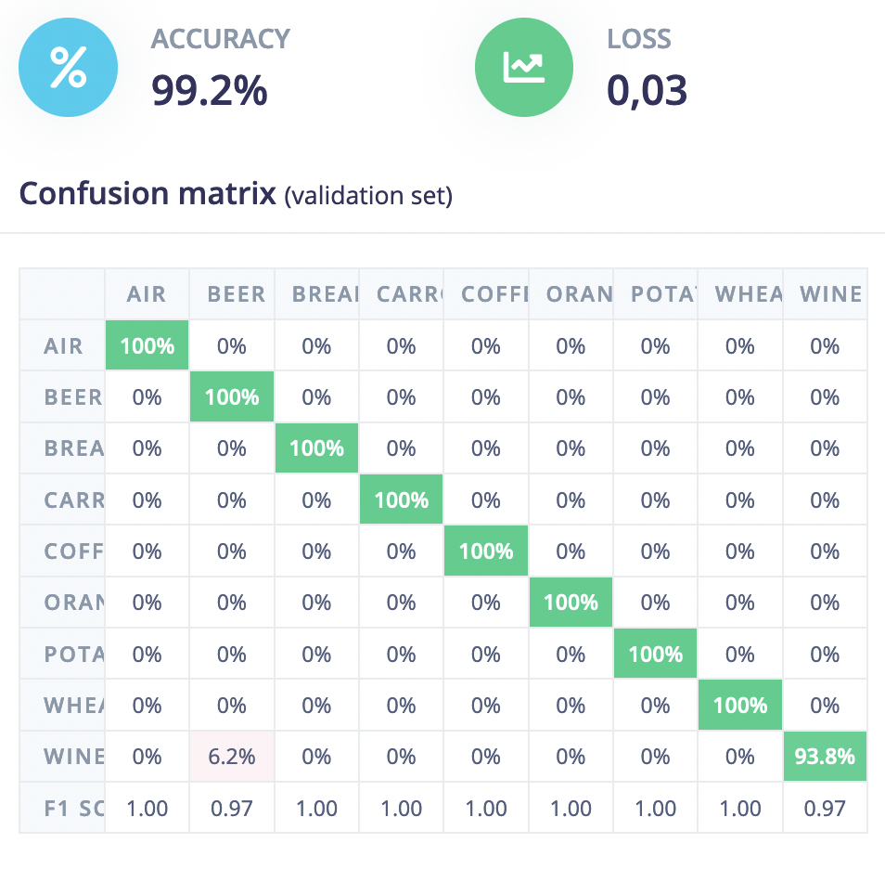
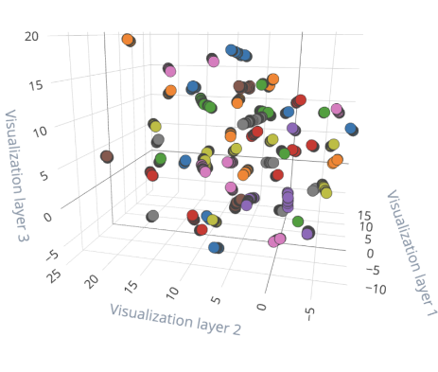
5. Prediction

Slide 22
6 Elements to be collected:
Nitrogen dioxide (NO2)
Ethyl alcohol (C2H5OH)
Volatile organic compounds (VOCs)
Carbon monoxide (CO)

Slide 23
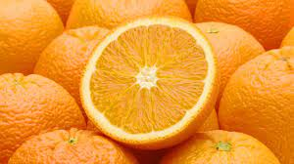
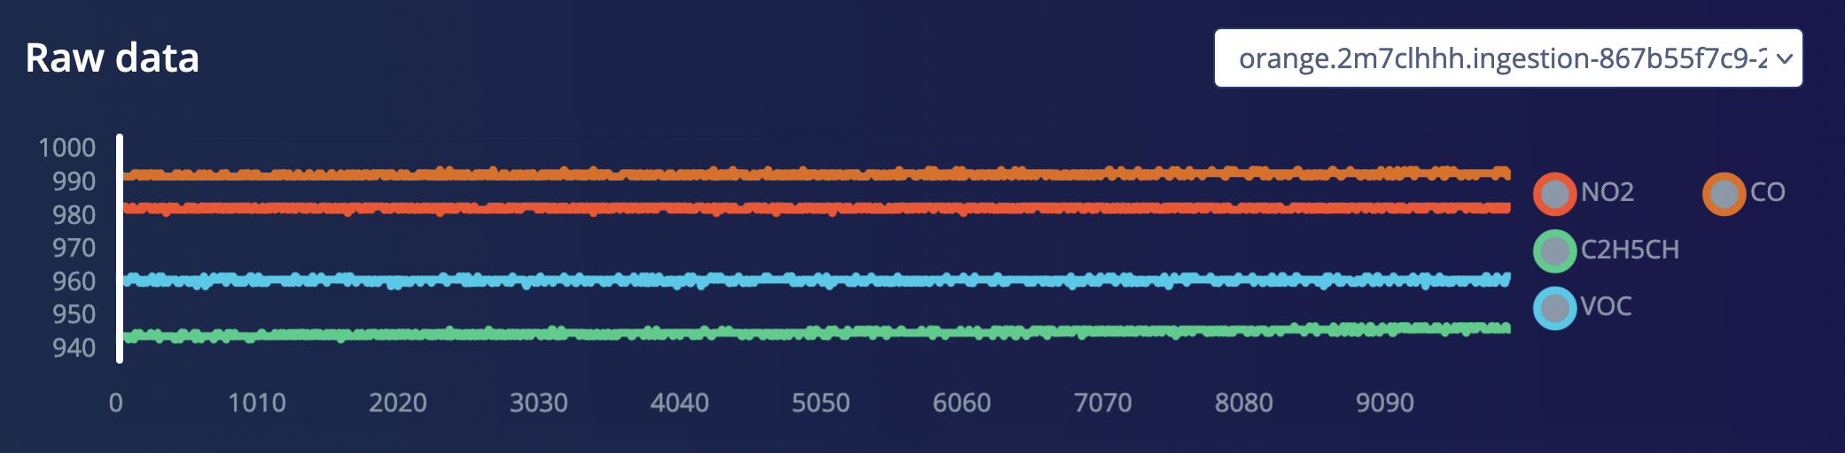
Orange 982, 944, 961, 992, 22, 55

Slide 24
